Slide 1

Computational Biology, Genetics and Epigenetics to Understand Disease Etiologies and Improve Precision Medicine
Dr. Shicheng Guo
Center for Precision Medicine Research
Marshfield Clinic Research Institute
15/05/2019
Notes:
Hi Everyone, Good Afternoon. Please first let me say thank to give me an opportunity to share the works what I have done in the past 10 years since my PhD training. This Aim of this presentation is to let know what I have done. What I am interested. What project I have charged or participated and played important roles in data analysis and manuscript preparation. It is not a easy job for me to give a comprehensive and detailed explanation for all the methods and conceptions. So when you listen to this presentation, try to capture the big pictures, try to capture the stories.

Slide 2
Outline
Human Complex Diseases and Precision Medicine
Identification of genetic variation for human complex diseases
Identification of Epigenetic biomarkers for human complex diseases
Plans to Obtain External Funding to Support my Research
Notes:
Automatic medicine

Slide 3
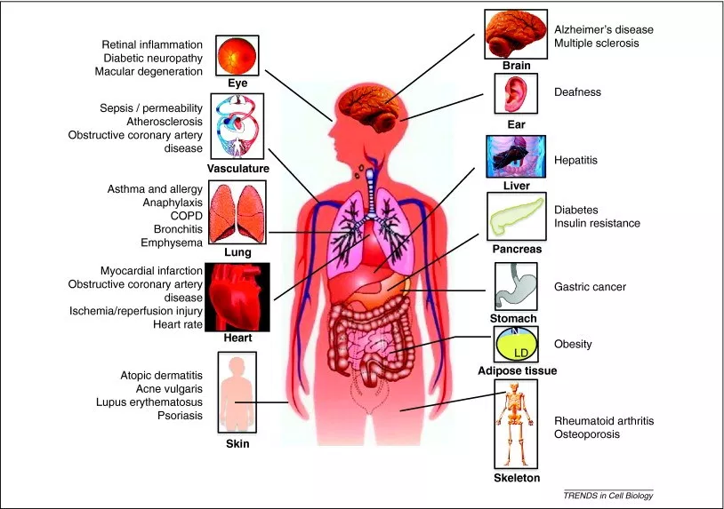
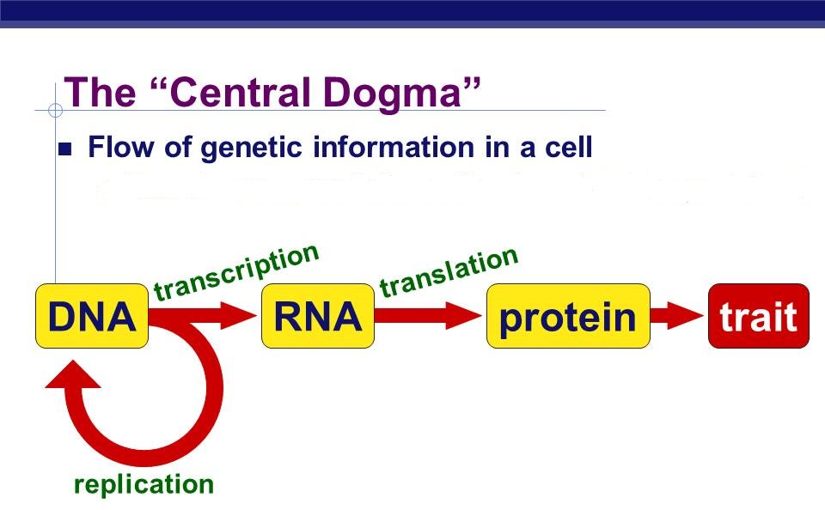
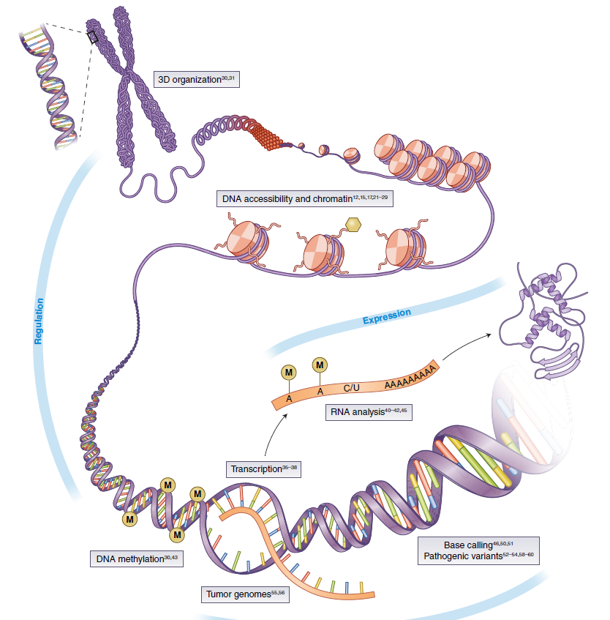
Macro and Micro View of Human Diseases in 21 Century
DNA/RNA/Protein Modification
~ 12,420 total diseases (WHO, 2011)
~ 80 different types of autoimmune diseases
~ 100 different types of human cancers
~ 7,000 rare diseases
Notes:
Let’s check what’s our understanding to disease now. We, human have almost 12 thousand disease including 80 autoimmune diseases, 100 cancers and more than 7,000 rare diseases. Except these, we don’t know how many infectious diseases. However, for all these diseases, we always can find the disease ideologies from tissues or cells. For example, DNA, RNA, protein or its related modifications, such as DNA methylation, miRNA or histone modifications.

Slide 4
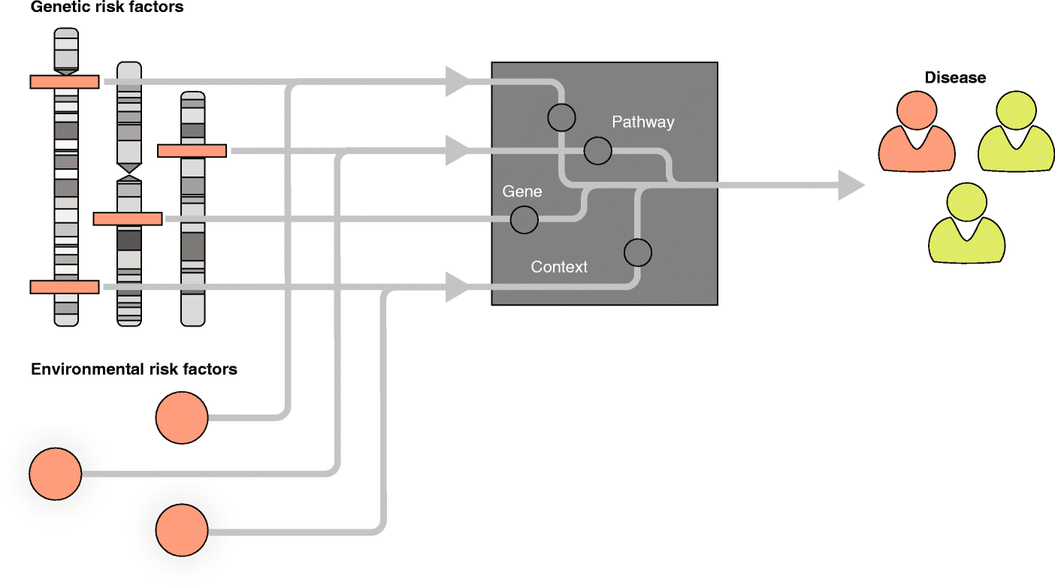
Computational Frame for Disease Etiology and Pathologies Research
Genetic risk factors
Clinical Phenotypes
Weeks
Years
Network
Pathological phenotypes
Image phenotypes
Environmental risk factors
Electroencephalography (EEG)
Electrocardiography (ECG)
Positron Emission Tomography (PET)
Magnetic Resonance Imaging (MRI)
X-Ray radiography image
Ultrasonography image
Epigenetics risk factors
Lifestyle risk factors

Slide 5

What is Precision Medicine?
Precision Medicine
Personalized Medicine
Smart Medicine
Smart Hospital
Automatic Medicine

Slide 6
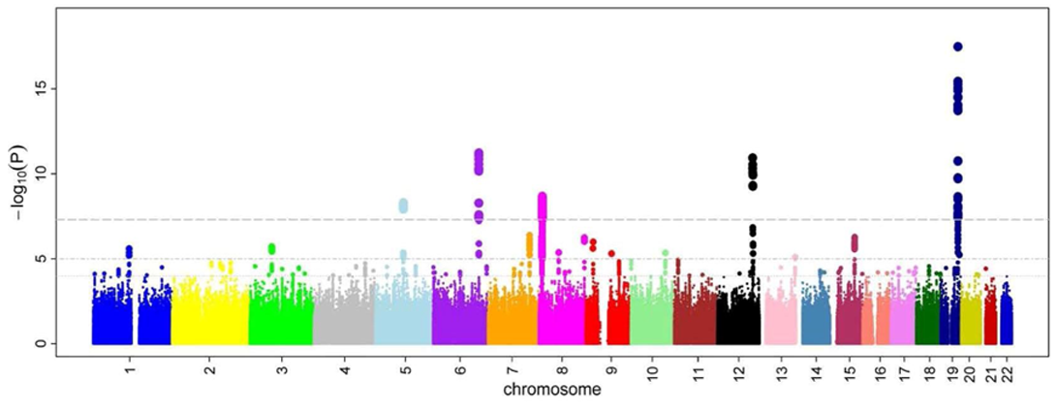
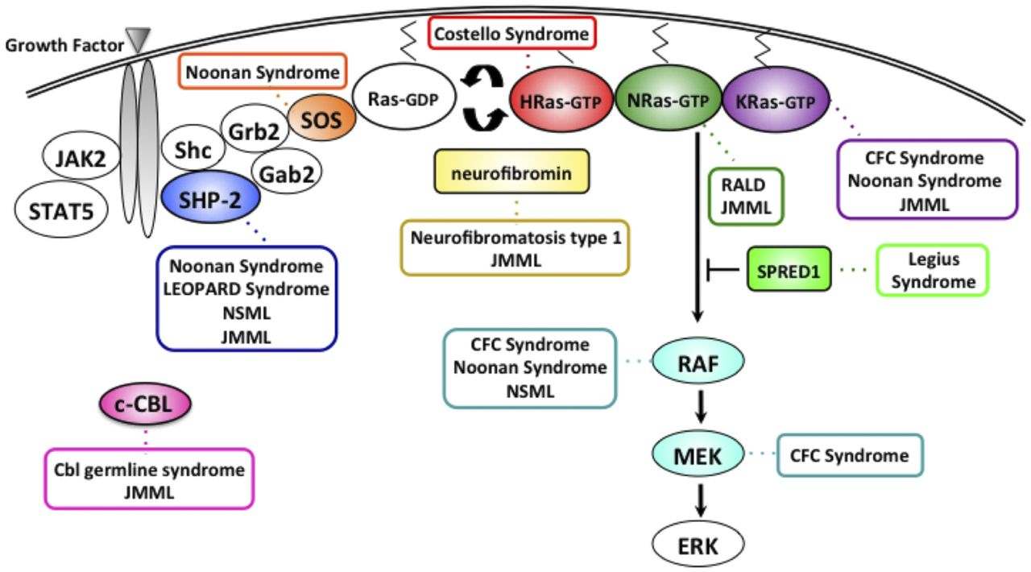
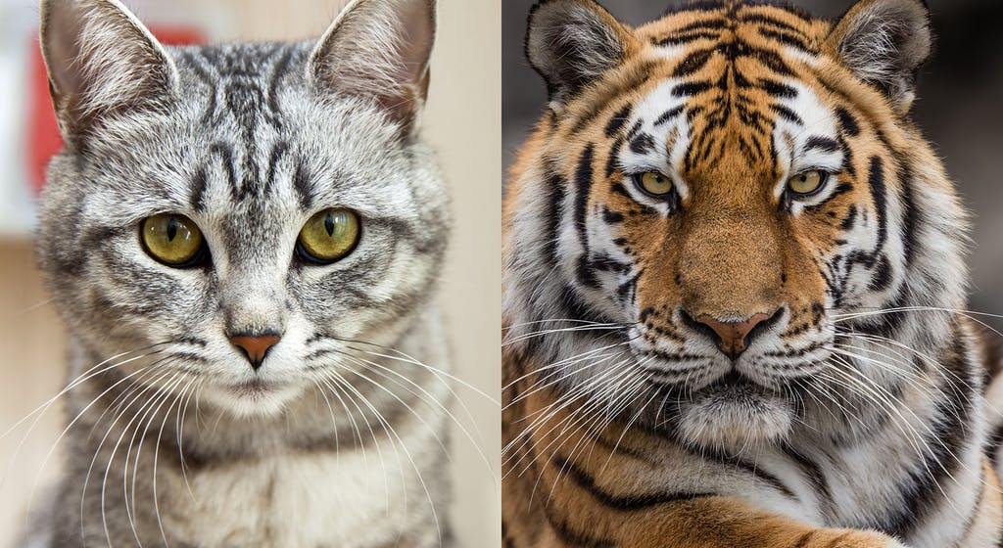
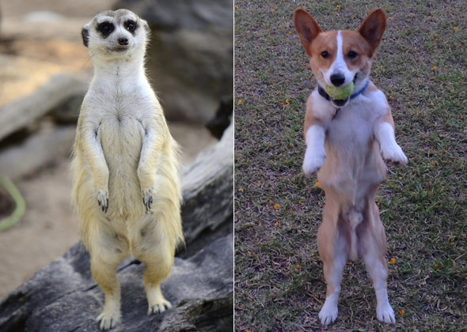
How to achieve Precision Medicine?
1. Direct way: to understand each diseases with deep knowledge
2. indirect way: it looks we are similar (Data Drive)

Slide 7
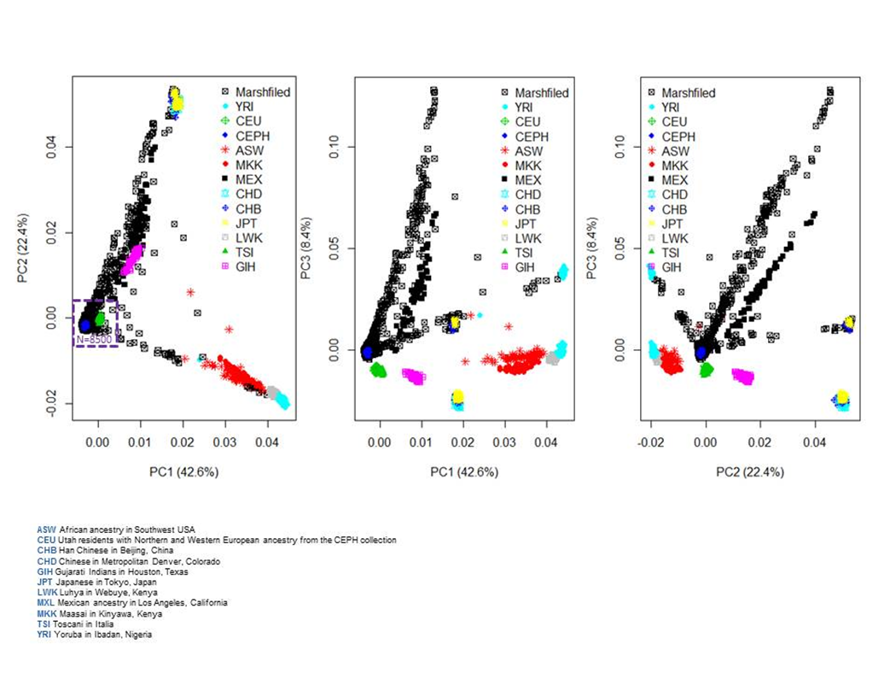

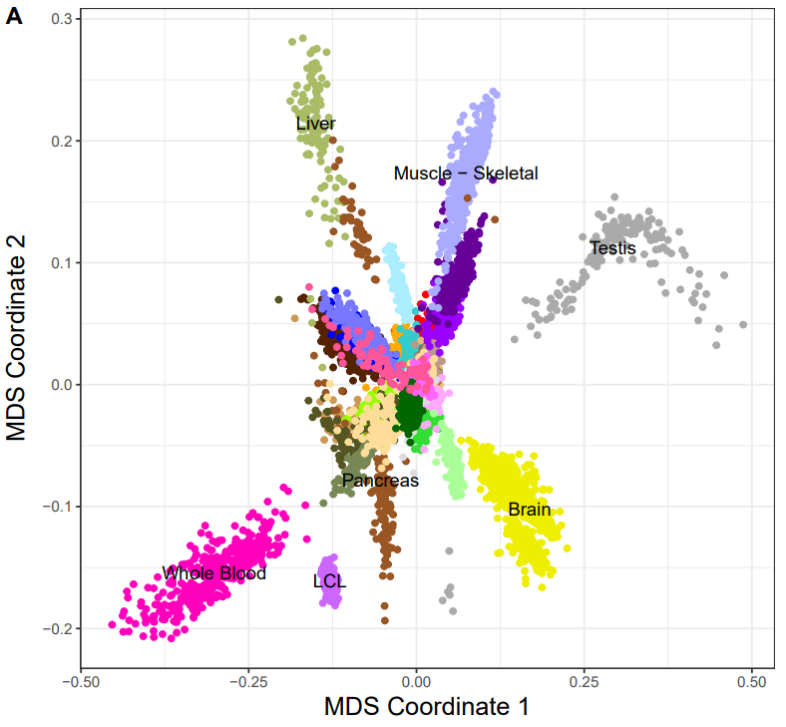
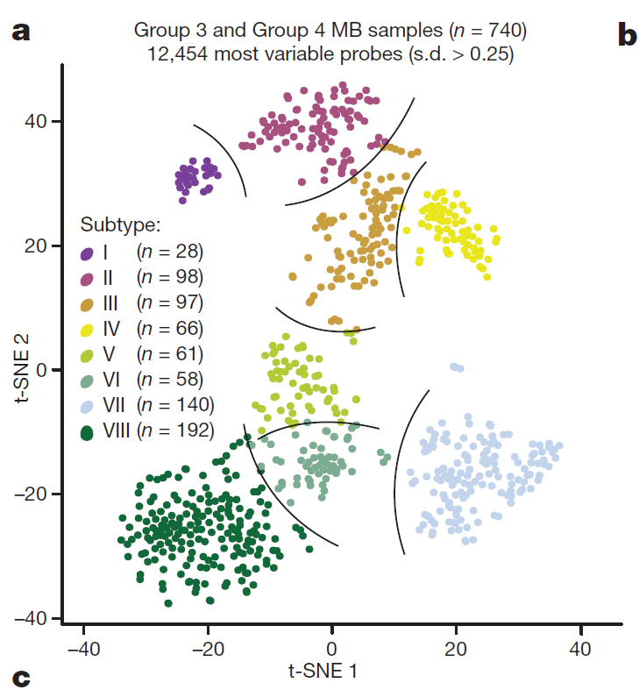
Individual, Tissue and Subtype Identification with Genomic Data
CoreExome Beadchip Genome-wide RNA-Seq data
Genome-wide DNA methylation data
Asian
Brain cancer
European
African
Brain
Unpublished data, Guo, Schrodi, 2019
Modified, Nature, 2017; 550 (7675): 204
Modified, Nature, 2017; 547 (7663): 314

Slide 8
Outline
Human Complex Diseases and Precision Medicine
Identification of genetic variation for human complex diseases
Identification of Epigenetic biomarkers for human complex diseases
Plans to Obtain External Funding to Support my Research
Notes:
Automatic medicine

Slide 9
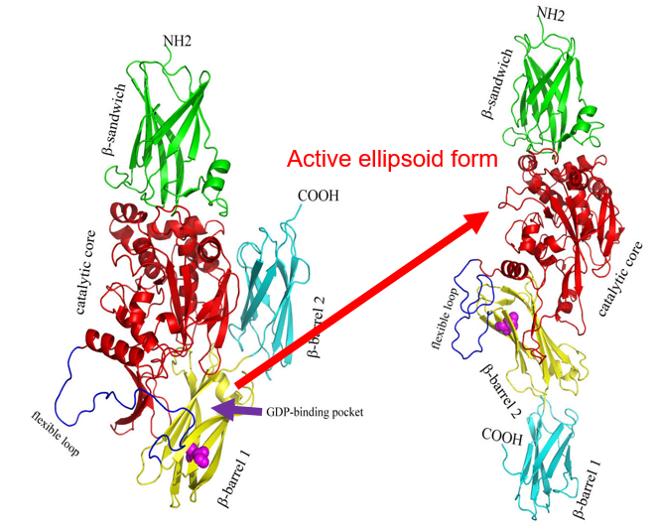
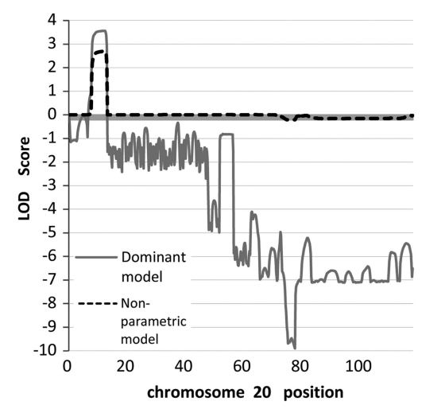
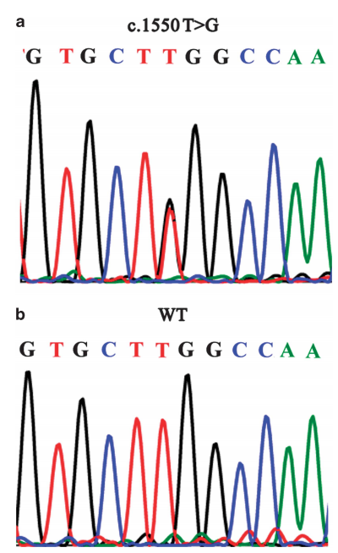
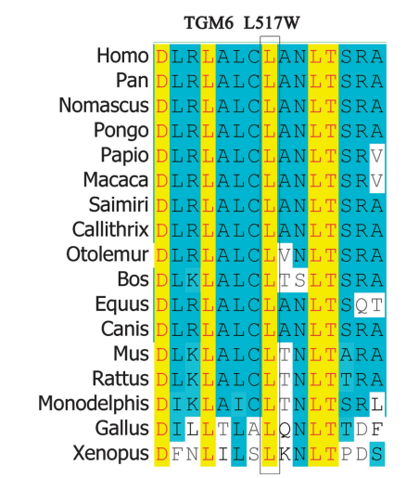
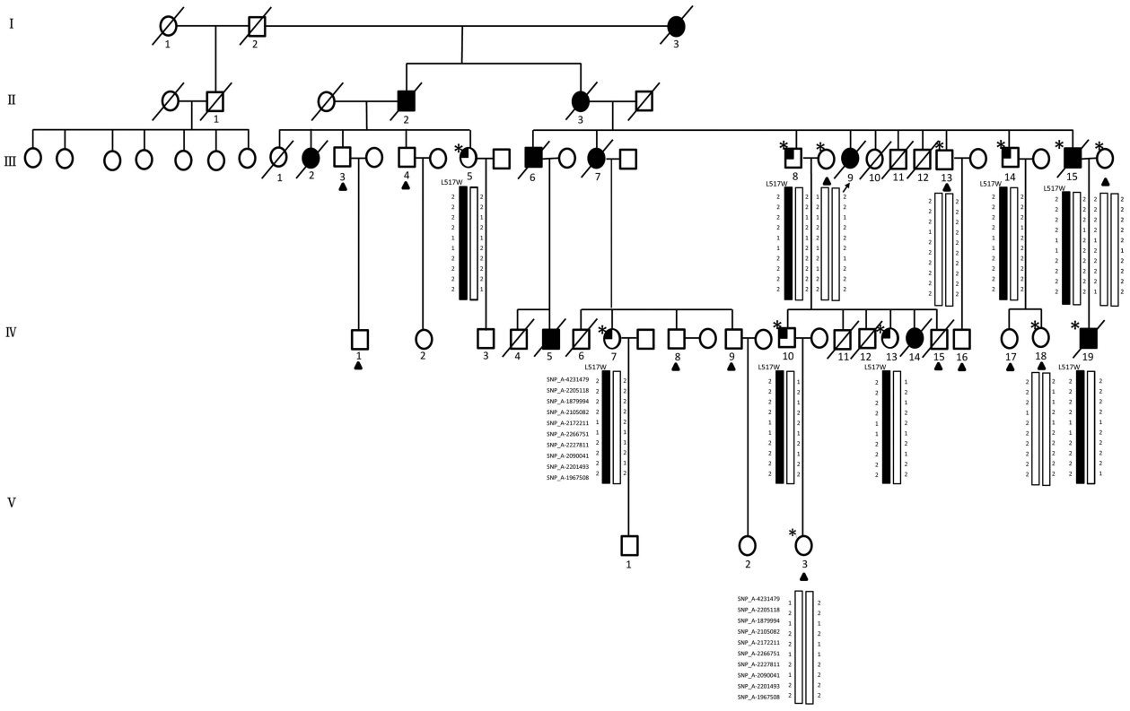
Linkage analysis to identify acute myeloid leukemia (AML) genes: TGM6
20p13
LOD: Logarithm of ODds
Autosomal-dominant AML family with 11 cases in four generations
Linkage analysis and targeted next-generation sequencing (NGS)
2 exonic variants (TGM6 and CENPB), 15 intronic, 15 intergenic and 4 UTR variants
TGM6: occurred in 2 patients and 6 members at potential pre-leukaemic phase, but not in 13 unaffected individuals and 530 ethnically matched healthy controls
Mutation might make TGM6 have strong GDP-binding ability and easy to transfer to active form.
Pan, .. ,Guo, Zhang, Huang, Lin, Wang. European Journal of Human Genetics (2015) 23, 218–223

Slide 10
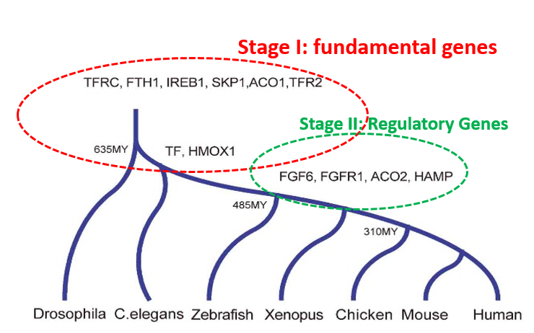
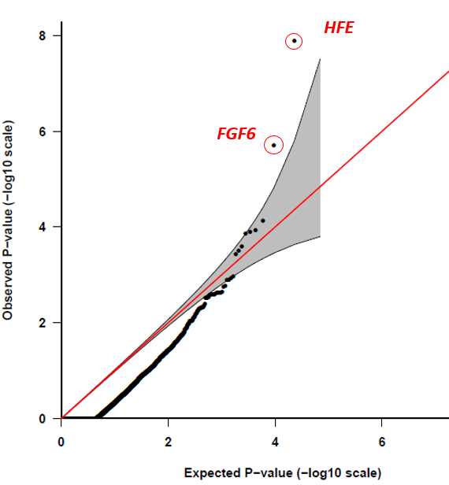
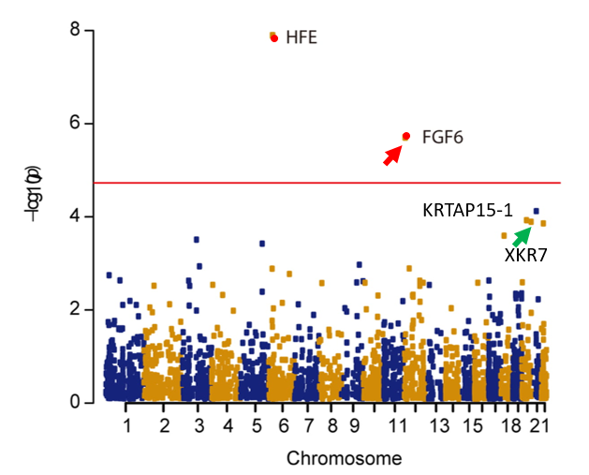
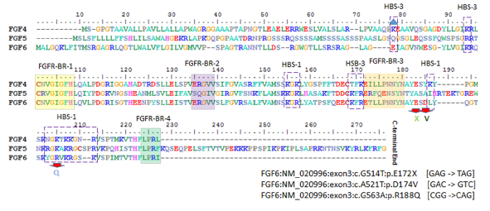
Gene-based recessive diplotype exome scan discovers FGF6 as a iron metabolism gene
PMRP: 18 HC (50% FGF6 -/-)
Fibroblast Growth Factor 6
Heparin-Binding Growth Factor 6
Guo, S. et al.. Blood 133, 1888-1898 (2019).

Slide 11
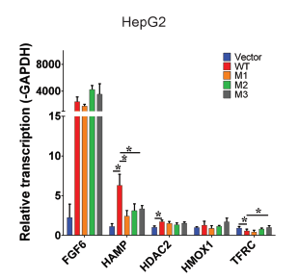
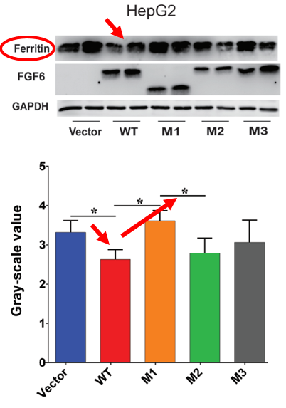
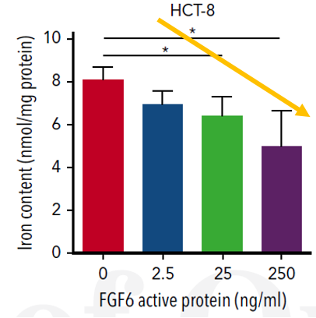
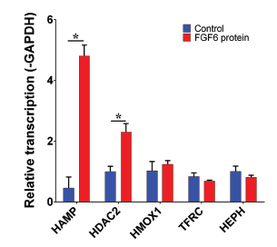
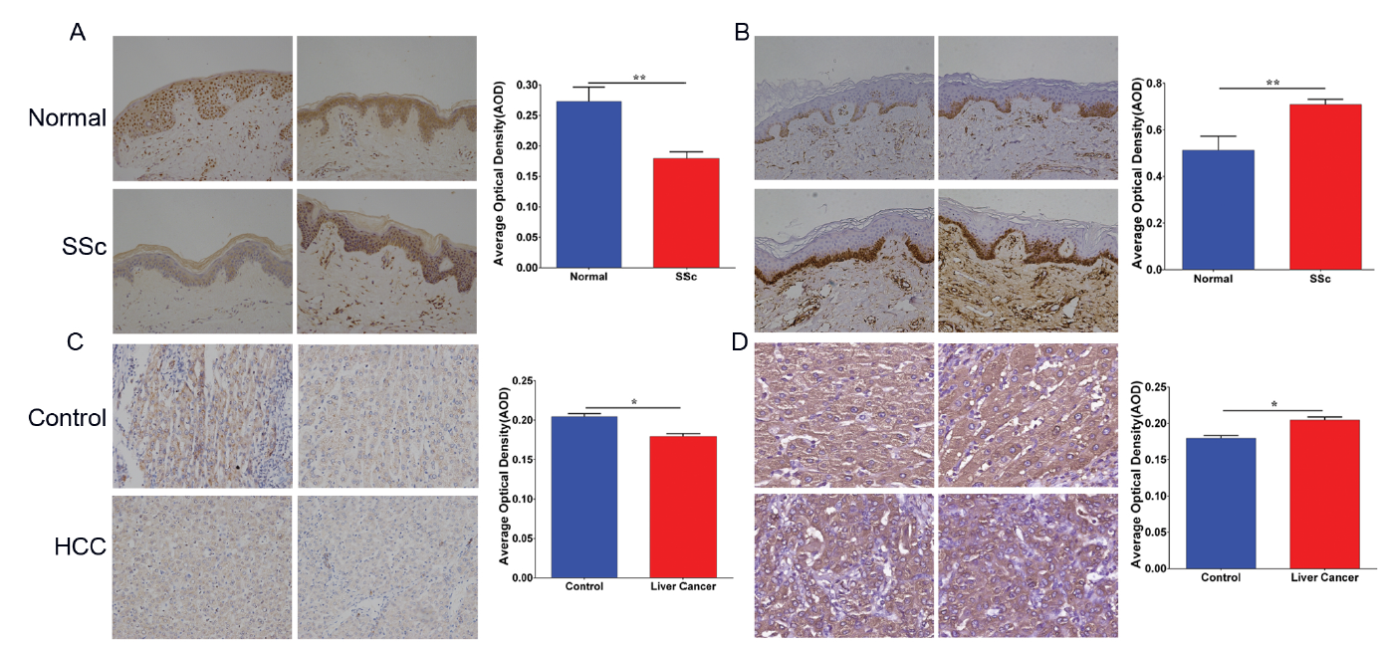
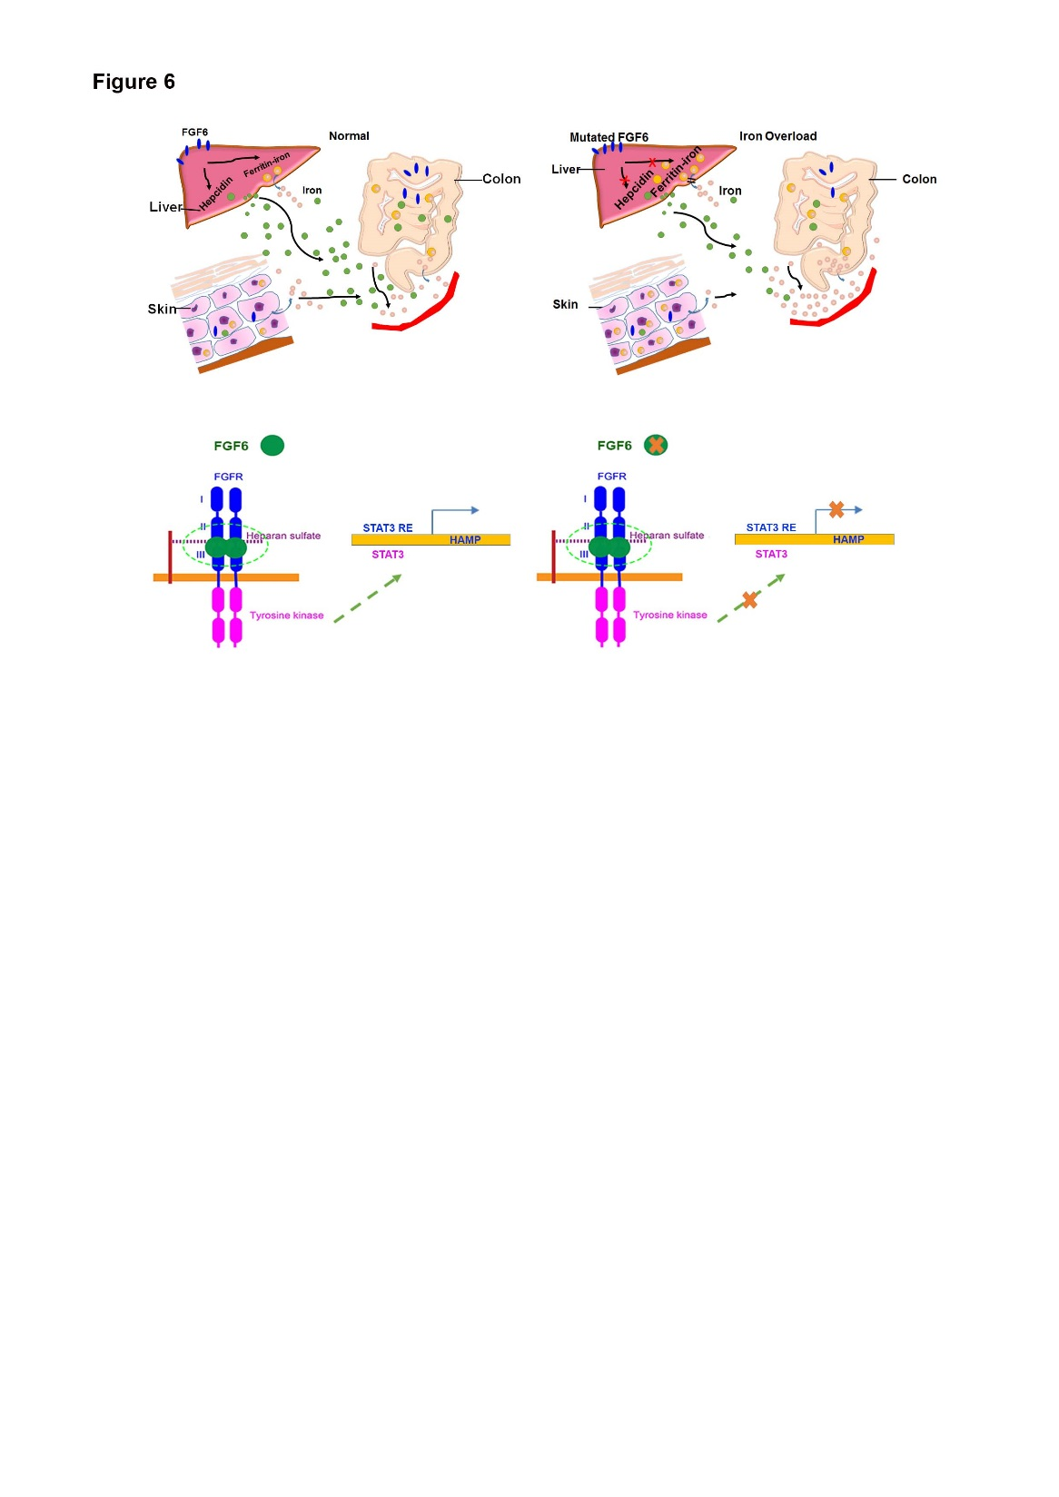
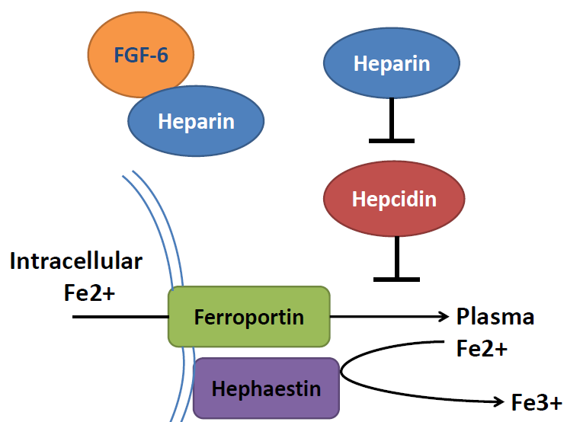
Molecular, Cellular and Immunohistochemistry to Validate FGF6 Functions
CTR
SSc
CTR
Ferrous form
HCC
Ferric form
Guo, S. et al. A gene-based recessive diplotype exome scan discovers FGF6, a novel hepcidin-regulating iron-metabolism gene. Blood 133, 1888-1898 (2019).

Slide 12
Outline
Human Complex Diseases and Precision Medicine
Identification of genetic variation for human complex diseases
Identification of Epigenetic biomarkers for human complex diseases
Plans to Obtain External Funding to Support my Research
Notes:
Automatic medicine

Slide 13
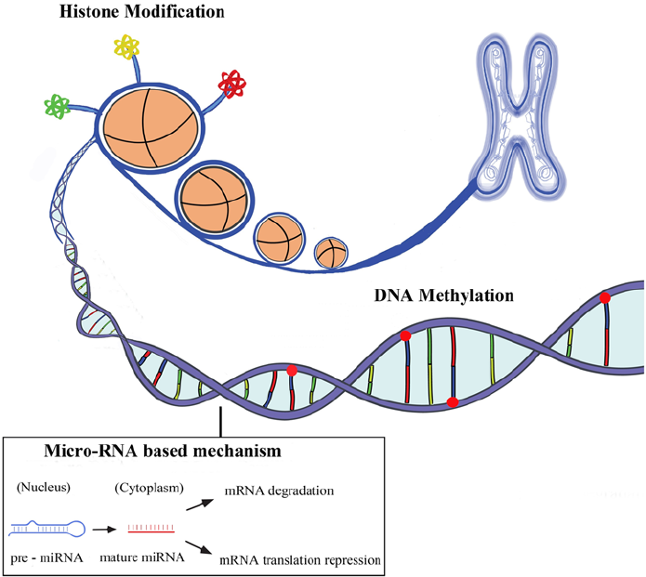
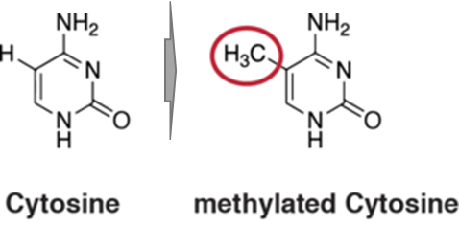
Human Genome and modification systems (Epigenetics)
DNA modification
DNA methylation
DNA hydroxymethylation
Histone modification
H3K4me1, H3K4me3
H3K27ac, H3K9ac
ncRNA system
miRNA
lncRNA
circRNA
piRNA
methyl group
Allis, Nature Review Genetics, 2016
Notes:
Our human genome is composed of A,T,C,G 4 different bases. However, human genome is not linear,

Slide 14
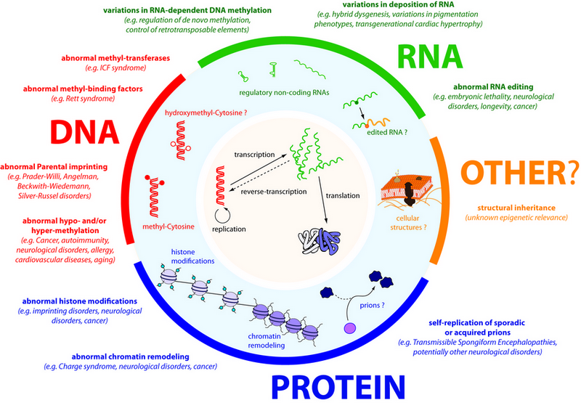
DNA methylation: powerful biomarkers for complex diseases
Almost all diseases showed abnormal methylation change
Aging can be highly predicted by methylation clock
High sensitivity: single molecular with PCR
Stable in vitro without degradation
High tissue and status specificity
Change earlier than mRNA and protein
Easy to be assembled to a multi-disease panel
Molecular biomarker, Wikipedia, 2019

Slide 15

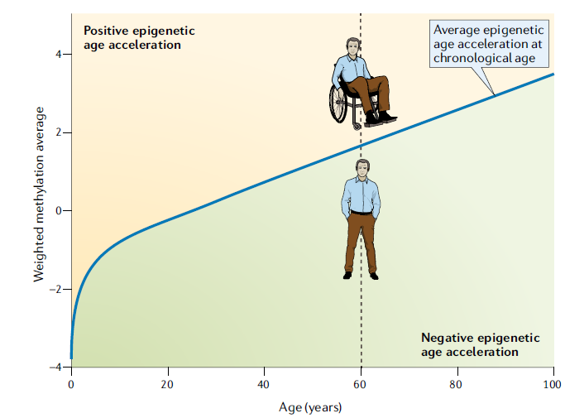
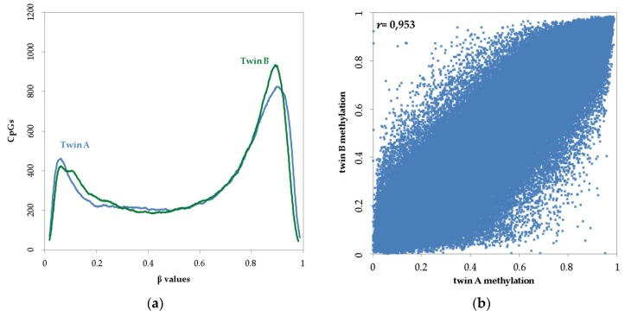
The Power of DNA methylation a biomarker
DNA ~100%
R²=0.91
DNA methylation-based age and age acceleration
Horvath, Nature Review Genetics, 2018
Guo, unpublished data
Kaminsky, Nature Genetics, 2009

Slide 16
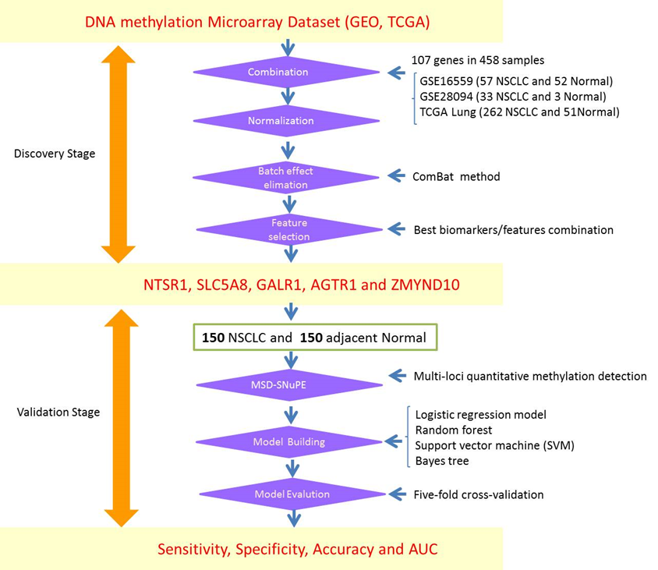
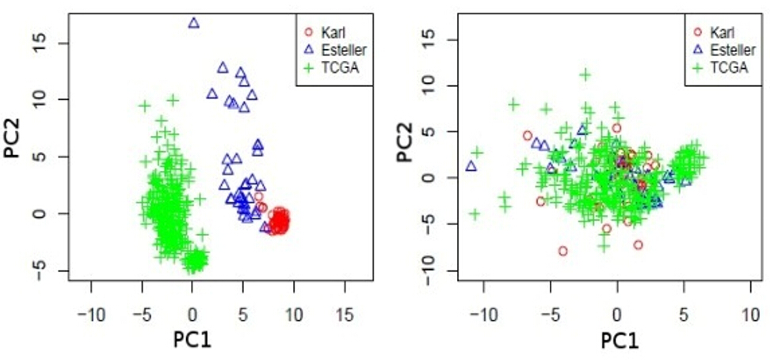
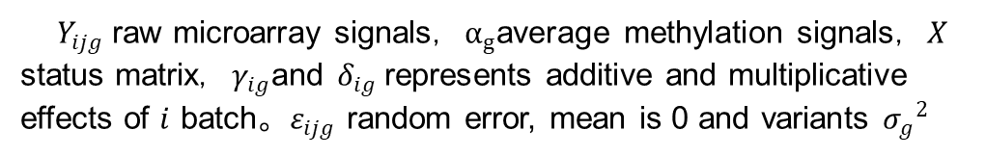
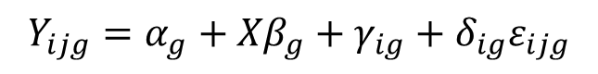
Identification and validation of the methylation biomarkers of non-small cell lung cancer (NSCLC)
$$Y_{ijg}=α_{g}+{Xβ}_{g}+γ_{ig}+δ_{ig}ε_{ijg}$$
$Y_{ijg}$ raw microarray signals，$α_{g}$average methylation signals，$X$ status matrix，$γ_{ig}$and $δ_{ig}$represents additive and multiplicative effects of $i$ batch。$ε_{ijg}$ random error, mean is 0 and variants ${σ_{g}}^{2}$
1
2
3
Guo, S et al (2015). Clin Epigenetics 7: 3

Slide 17
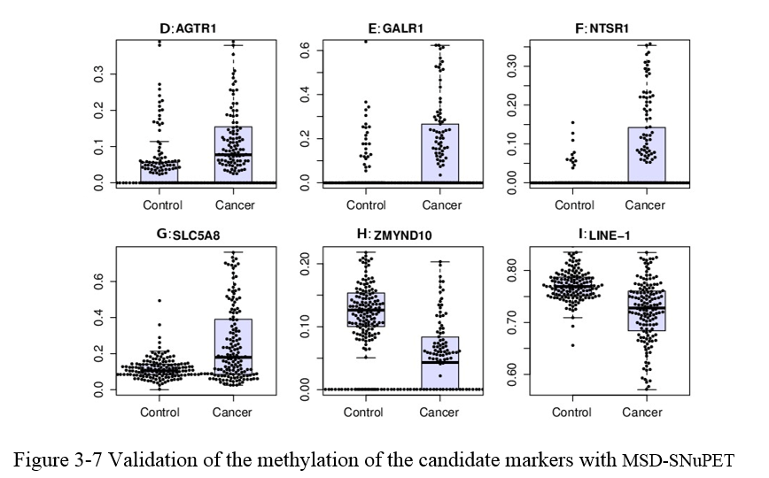
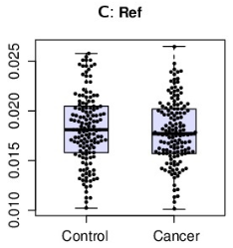
Methylation Status Determined-Single Nucleotide Primer Extension Technique (MSD-SNuPET) based Cancer Prediction
 | Train |  |  | Test
 | SEN | SPE | ACC | SEN | SPE | ACC
Logistic Reg | 0.79 | 0.99 | 0.89 | 0.78 | 0.97 | 0.87
SVM | 0.90 | 0.98 | 0.94 | 0.86 | 0.94 | 0.90
Random Forest | 0.93 | 0.93 | 0.93 | 0.89 | 0.89 | 0.89
Bayes Tree | 0.91 | 0.98 | 0.94 | 0.86 | 0.96 | 0.91
Neural Network | 0.80 | 0.90 | 0.88 | 0.75 | 0.89 | 0.80
KNN (K=2) | 0.60 | 0.95 | 0.96 | 0.71 | 0.92 | 0.79
FPCA | 0.84 | 0.96 | 0.90 | 0.82 | 0.88 | 0.84
P=0.285
 | NSCLC | CTR | Sen | Spe | AUC
AGTR1 | 12.88% | 4.48% | 59.73% | 79.59% | 0.71
GALR1 | 18.31% | 2.91% | 46.98% | 85.03% | 0.67
NTSR1 | 9.37% | 0.56% | 44.30% | 94.56% | 0.70
SLC5A8 | 25.59% | 11.66% | 52.35% | 88.44% | 0.67
ZMYND10 | 6.95% | 12.82% | 73.15% | 92.52% | 0.80
Summary:
Data integration of DNA methylation is helpful.
Batch effect is strong between different platform.
MSD-SNuPET could be applied for biomarker identification
Bayes Tree and Random Forest is powerful for prediction

Slide 18
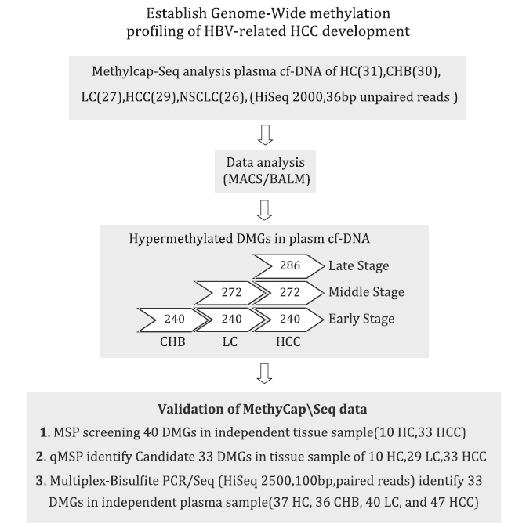
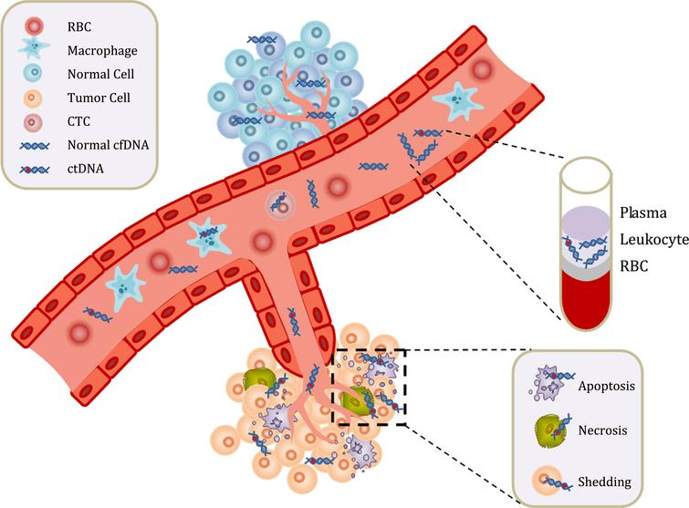
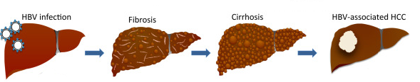
Epigenome analysis of serum cell-free circulating DNA in progression of HBV-related Hepatocellular carcinoma
HC, healthy control;
CHB, HBV-related hepatitis
LC, HBV-related liver cirrhosis;
HCC, HBV-related hepatocellular carcinoma
HBV infection
Fibrosis
Cirrhosis
HBV-associated HCC
Process of Hepatitis B Virus-Associated Hepatocellular Carcinoma
Zhao Y, Xue F, Sun J, Guo S et al. Clin Epigenetics 2014;6(1):30. PMID: 25859288

Slide 19
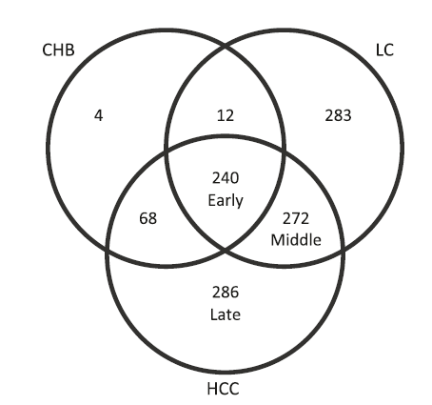
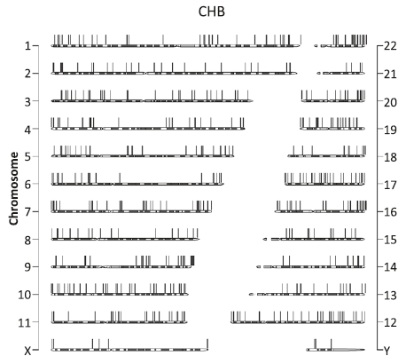
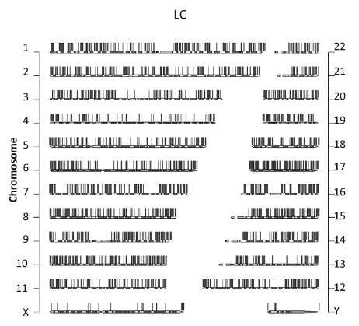
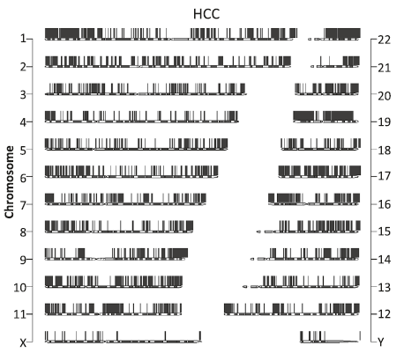
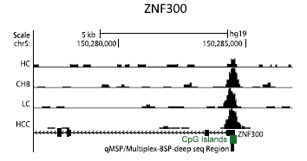
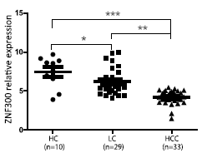
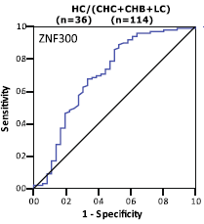
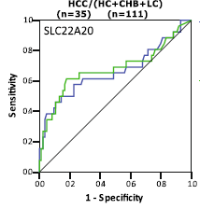
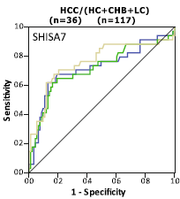

Epigenome analysis of serum cell-free circulating DNA in progression of HBV-related Hepatocellular carcinoma
HBV-related hepatitis HBV-related liver cirrhosis HBV-related HCC
AUC=0.7
AUC=0.68
AUC=0.76
Data Availability : GSE54961
Zhao Y, Xue F, Sun J, Guo S et al. Clin Epigenetics 2014;6(1):30. PMID: 25859288

Slide 20


Methylcap-seq reveals novel DNA methylation markers for the diagnosis and recurrence prediction of bladder cancer
T24, 5637
BN1, BN2
BWA
Samtools
Picard
MACS2
MethylCap-Seq
BCC Normal (5637+T24) (N1+N2)
Reads(72bp) | 6,232,852 | 6,230,959
Total bases recalled | 473,696752 | 473,552,884
Base Q20 | 0.9143 | 0.909
Peaks (P<E-3) | 210,051 | 229,538
High-DMR | 70,432 | 83,690
DMR with refGene | 55,237 | 45,522
DMR with CGI | 21,179 | 1,945
DMR (refGene + CGI) | 4,256 | 401
DMR (promoter) | 1,627 | 66
Mayo Clinic Website, 2019
MBDCap-Seq/MethylCap-Seq/MBD-Seq/MBDCap/MiGS
Methods. Volume 52, Issue 3, 2010, 232-236
Zhao, Y., S. Guo, J. Sun et al. (2012). PLoS One 7(4): e35175

Slide 21

Validate Methylcap-seq library with BSP and Previous Publication
Previous Reported 21 DMR
1627 + 66 DMRs
19/21（90.5%）
22 + 2 DMRs
23 Validated
Consistency: 96%
Clinical Cancer Research 2011
Cancer EpiBiomaK Prev，2011
High quality Methylcap-seq library
8/9 validated（88.9%）
Zhao, Y., S. Guo, J. Sun et al. (2012). PLoS One 7(4): e35175

Slide 22
Validate Methylcap-seq library with BSP and Previous Publication
Most Significant
104 genes
Samples
2 Cancer cell lines
2 Normal cell lines
8 Normal tissues
 | Bladder cancer | BC vs NC (n=149) | BC vs NCL(n=41)
 | Sensitivity(%) | Specificity (%) | Specificity (%)
 | (pos./total) | (neg./total) | (neg./total)
VAX1 | 42.45(90/212) | 95.31(142/149) | 87.81(36/41)
KCNV1 | 36.92(84/212) | 93.96(140/149) | 95.12(39/41)
ECEL1 | 26.89(57/212) | 97.31(145/149) | 97.56(40/41)
TMEM26 | 26.42 (56/212) | 96.64(144/149) | 97.56(40/41)
PROX1 | 24.53(52/212) | 98.66(147/149) | 100.0(41/41)
TAL1 | 24.83(52/212) | 98.66(147/149) | 100.0(41/41)
SLC6A20 | 15.57(33/212) | 97.89(146/149) | 100.0(41/41)
LMX1 | 9.43(20/212) | 98.66(147/149) | 100.0(41/41)
CFTR | 52.35(111/212) | 96.64(144/149) | 97.56(40/41)
Panel | 88.7(188/212) | 87.3(130/149) | 85.4(35/41)
MSP assay
50%, 25.0%
49 Genes
26 samples：
8 Normal tissues
18 bladder cancers
MSP assay
17%, 12.5%
9 methylation biomarkers
VAX1
KCNV1
ECEL1
TMEM26
TAL1
PROX1
SLC6A20
LMX
Single Marker: Sensitivity: 9.4%-42.5%
402 Urine Samples：
149 Urine: Normal CTR
212 Urine: BC patients
41 Urines: noncancerous lesions
Multiple Marker: Sensitivity: 76.9%-88.7%
Multiple Marker Panel: AUC: 82%-90.0%
Zhao, Y., S. Guo, J. Sun et al. (2012). PLoS One 7(4): e35175

Slide 23
Application of DNA methylation Panel in Diagnosis and Surgery Evaluation
48 suspected bladder cancer patients
26 Confirmed BCC
Cystoscopy
Methylation Panel
32 BCC
16 non-BCC
21 Methylation Positive Patients
Methylation Panel
Bladder Cancer Remove Surgery
25 BCC
SEN=78.1%
14 non-BCC
SPE=87.5%
19 Negative
2 Positive
P<0.0001
24 month Follow-Up
Surgery Success Ratio：91%
Lost Follow-Up
1/2 individuals diagnosis as BCC
Zhao, Y., S. Guo, J. Sun et al. (2012). PLoS One 7(4): e35175

Slide 24
Cell-free Circulating Tumor DNA (ctDNA) in human Carcinoma
ctDNA 10-200ng/ul Plasma
Non-random distributed, repeat regions
Non-invasive diagnosis and real-time surveillance
Circulating tumor DNA, Wikipedia, 2019

Slide 25




Methylation Haplotype and Methylation Haplotype Load
l: length of haplotype
$w_{i}=i$ or $w_{i}=i^{2}$
Methylation level and pattern of co-methylation (complexity)
Guo, 2017, Nature Genetics

Slide 26

Tissue clustering based on cell-free circulating DNA methylation
Endoderm Mesoderm Ectoderm
Unsupervised clustering of human tissues using the top 15% most-variable regions from WGBS
We identified numerous germ-layer-specific methylation markers
Guo, Nature Genetics, 2017

Slide 27


Tissue specific hyper-methylation MHB regions show tissue specificity
MHL

Slide 28


Performance of tissue-specific MHL based tissue-of-origin mapping
Sensitivity: 87.9%
Sensitivity: 87.6%
Specificity: 90.2%

Slide 29
Outline
Human Complex Diseases and Precision Medicine
Identification of genetic variation for human complex diseases
Identification of Epigenetic biomarkers for human complex diseases
Plans to Obtain External Funding to Support my Research
Notes:
Automatic medicine

Slide 30
Future External Grant Opportunity
Bioinformatics + Epigenetics
Contribution of Genetics variations in Epigenetics factors to human diseases
Cell-free DNA methylation based Pan-cancer early screening in PMRP cohort
Epigenetic landscape of atrial fibrillation (Dr. Caldwell)
Epigenetic, longevity, methylation clock and telomeres (Dr. Hebbring)
Epigenetic changes in microbiome induced diseases(Dr. Shukla)
Epigenetic signatures to birth defect disease (Dr. Carter)

Slide 31


Contribution of Genetics Variations in Epigenetics Factors to Human Diseases
More and more epigenetic factors were designed as drug targets
Genetic variants in these epigenetic factors will be hot-topic in PGx
PheWAS study to genetic variations in Epigenetics factors is quite interesting
Heritability (h²)
Shared environmental effects (c²)
Polderman et al. (2015) Nature Genetics, 47(7), 702-709.
Medvedeva, Y.A. et al. Database (Oxford) 2015
This idea and proposal is approved by CIBM program

Slide 32
PheWAS Maps Genetic Variation in Epigenetic Factors with Human Disease
Genome-wide
Exome-Array
6,221 Phenotypes
Multi-class classification to genetics and epigenetics features
Random forecast
SVM
Neural network
Variations in Epigenetic Factors
5873 SNPs (P<8.5x10⁻⁶)
Traditional Statistic Method? Propose new method?
Allele based? Gene-based?
How to estimated power?
How to reduce false positive?
Build a R package for this project to be used for further analysis
Significant Genes and 100 Phenotypes ?
Prediction model for Genetic and Epigenetic related diseases
Validate association with bioinformatics
Validate association with BS-Sequencing
20 Phenotypes
Validate association with MH450K array
Validate association with RRBS

Slide 33

Preliminary Result: Phenome-wide Association Study Maps Genetic Variation in Epigenetic Factors with Human Complex Disease
IRB for 6221 phenotype… We have 15 approved phenotypes
Rheumatoid Arthritis (RA) (h2=0.6)
Systemic Lupus Erythematosus (SLE)
Multiple Sclerosis (MS)
Type 1 Diabetes (T1D)
Hemochromatosis
Premature Myocardial Infarction (PMI)
Chronic Lymphocytic Leukemia (CLL)
Obsessive Compulsive Disorder (OCD, h2=0.29)
Autoimmune Thyroid Disease (ATD)
Axial Spondyloarthritis (AS)
Psoriatic Arthritis (PA)
Autoimmune Thyroid Disease (ATD)
Systemic Sclerosis (SSc)
Chronic Lymphocyte Leukemia
Severe Stage Glaucoma
Iron overload (h2=0.25-0.4)
1737 Significant Signals
Iron overload
BRCA1
OCD and OCPD
Rheumatoid Arthritis
I have Nature Genetics paper in Epigenetics and Blood paper in Genetics. I can convince the reviewer that I have interaction analysis experience between genetics and epigenetics after this CIBM project. Finally, I will prepare a genetics and epigenetics RO1 proposal in T2D, Obesity or Rheumatoid Arthritis

Slide 34










Mapping Genetic Variation in Epigenetic Factors to potential specific cell types and diseases
PheWAS identified Phenotype Assocatied Epigenetic Factors
Tissue specific and Disease associated Epigenetics Genes
Tissue and Phenotype Deconvolution

Slide 35
Cell-free DNA methylation based Pan-cancer early screening in PMRP cohort
1st Author: Nature Genetics, Clinical Epigenetics, Modern Rheumatoid Arthritis
Co-corresponding authors: Clinical Epigenetics, Frontier in Genetics, Cell Death Disease
Co-authors: Nature, Nature biotechnology, PLoS biology, Neoplasia
Another 2 methylation manuscript collaborated with Stanford, BIG et. will be submitted soon
Totally, I have more than 24 methylation papers published in past 10 years
Data collection, analysis and preliminary data
TCGA Pan-cancer dataset: 11,706 RNA-seq, 12,359 DNA methylation, 11,315 Mutation
33 cancer types, 746 normal, 10,192 cancer, 90% samples have overall survival time
Blueprint, Encode, GTEx, UK-biobank-GWAS, Fantom5
SVM, Random Forest, Neural Network and other 6 machine learning platform are deployed in HPC
PRMP phase 1 and phase 2 have been cleaned, imputed and be ready to do genetic analysis
Number of cancer patients in PMRP have been checked and plasma can be requested after IRB

Slide 36



Unsupervised cluster analysis reveals cancer and normal similarity
Distance= 1-correlation
Cluster= mcquity
Pan-cancer methylation microarray dataset
11 cancer types
349,049（CpGs）$×$1278（Samples）
Guo, unpublished data

Slide 37


Tumor heterogeneity revealed by genome-wide DNA methylation
Lung Cancer R=0.90
KIRC and KIRP
Kidney Clear Cell Carcinoma
Kidney Papillary Cell Carcinoma
Liver Cancer R=0.84
Kidney
R=0.97
KIRC/KIRP R=0.92
LUAD UCEC COAD LUSC KIRP LIHC PRAD HNSC THCA BRCA KIRC
Cancer samples
Normal samples
Guo, unpublished data

Slide 38


Multi-label Classification to Pan-cancer with Random Forest Method
 | Variable=25 |  |  | Variable=75
 | Sen | Spe | Acc | Sen | Spe | Acc
BRCA | 0.85 | 0.97 | 0.91 | 0.94 | 1.00 | 0.97
COAD | 0.72 | 0.85 | 0.78 | 0.92 | 0.89 | 0.91
HNSC | 0.58 | 0.72 | 0.65 | 0.94 | 0.90 | 0.92
KIRC | 0.99 | 1.00 | 0.99 | 0.99 | 1.00 | 0.99
KIRP | 0.84 | 1.00 | 0.92 | 0.91 | 1.00 | 0.96
LIHC | 0.87 | 0.96 | 0.92 | 0.92 | 0.98 | 0.95
LUAD | 0.27 | 0.73 | 0.50 | 0.58 | 0.85 | 0.71
LUSC | 0.63 | 0.93 | 0.78 | 0.78 | 0.93 | 0.85
PRAD | 0.78 | 0.82 | 0.80 | 0.86 | 0.84 | 0.85
THCA | 0.79 | 0.88 | 0.83 | 0.88 | 0.96 | 0.92
UCEC | 0.57 | 0.77 | 0.67 | 0.77 | 0.97 | 0.87
25-75 CpGs provide ~80% accuracy to 22 sample types
Guo, unpublished data

Slide 39


Cancer diagnosis panels to be validated in the plasma using cell-free DNA methylation
GBM: IRF4, MGMT, CD133, ARF1,C2orf40,
NULL
BRCA
COAD
GBM
HCC
KIRC
LUAD
LUSC
PRAD
UCEC
PBMC
B-cells
Neutrophil
CD4+
CRC
AML
BML
GBM
BCRA
HepG2
NSLCL
RA
OA
Brain
TCGA+GEO: 11846 cancer samples
Support vector machine (five-fold cross-validation)
Guo, unpublished data

Slide 40



Long History of Precision Medicine of Marshfield Clinic
EHR
Precision Medicine initiative (PMI)
1960
ICD-9
2007
2019
1916
1990
2015
ICD-10
eMERGE Network
CPMR
Notes:
https://en.wikipedia.org/wiki/Marshfield_Clinic

Slide 41


Big Data: The Key to Reveal Disease Heterogeneity / Subtypes
Anti-CCP
RF-IGG
ESR
CRP
RF-IGA
RF-IGM
Unpublished data, Guo, 2019

Slide 42

Informatics Strategy: Key to Precision Medicine Success
Genetic risk factors (w_{i})
Clinical Phenotypes
Weeks
Years
Image phenotypes (w_{x})
Pathological phenotypes (w_{u})
Environmental risk factors (w_{j})
Epigenetics risk factors (w_{p})
Non-Supervised Machine-Learning
Neural Network based Deep-Learning
Lifestyle risk factors (w_{q})

Slide 43
Epigenetic landscape of atrial fibrillation (Dr. Caldwell)
Epigenetic, longevity, methylation clock and telomeres (Dr. Hebbring)
Epigenetic changes in microbiome induced diseases(Dr. Shukla)
Epigenetic signatures to birth defect disease (Dr. Carter)
~ 12,420 total diseases (WHO, 2011)
~ 80 different types of autoimmune diseases
~ 100 different types of human cancers
~ 7,000 rare diseases
WGBS for common cancers: ~20/100=20%
WGBS for rare diseases: ~ 1/1000=0.1%
WGBS for autoimmune diseases: ~ 4/80=5%
All these are opportunities and just need hardworking to achieve them

Slide 44




Acknowledgements
Dr. Li Jin
Fudan University
Dr. Momiao Xiong
University of Texas
Dr. Kun Zhang
UCSD
Dr. Steven Schrodi
MCRI
2009-2015
2013-2015
2015-2017
2017-2019
Shanghai, China Houston, TX San Diego, CA Marshfield, WI

Slide 45
Dr. Shicheng Guo
Guo.Shicheng@marshfieldresearch.org

